Slide 1

_{UP}
_{Japanology}
_{society}
_{orientation}

Slide 2

It was February 24, 2004, when 23 students and a professor, sharing a common interest in Japanese culture, established an organization committed in sharing this knowledge and interest.
_{HISTORY}

Slide 3

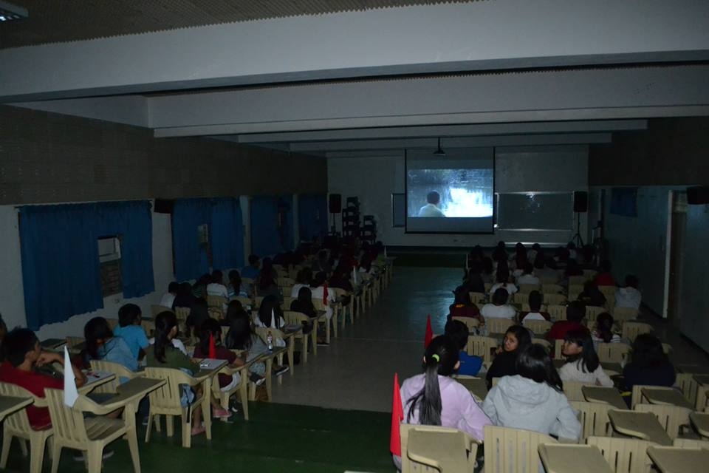
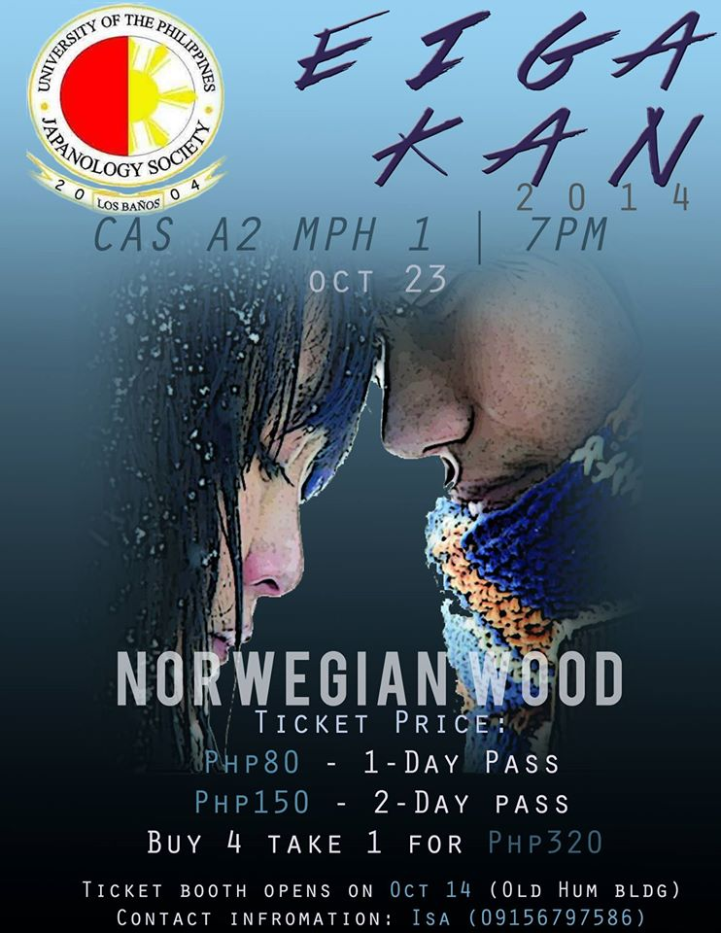
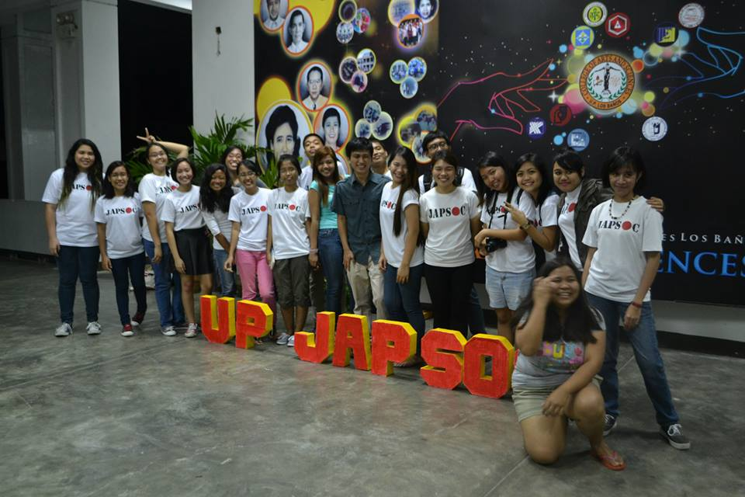
_{org} activities
eigakan
A film showing featuring the org’s picks of Japanese movies.

Slide 4

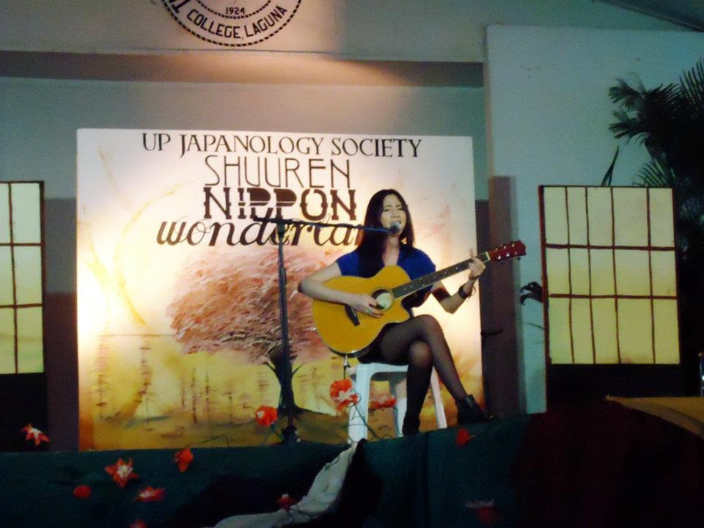
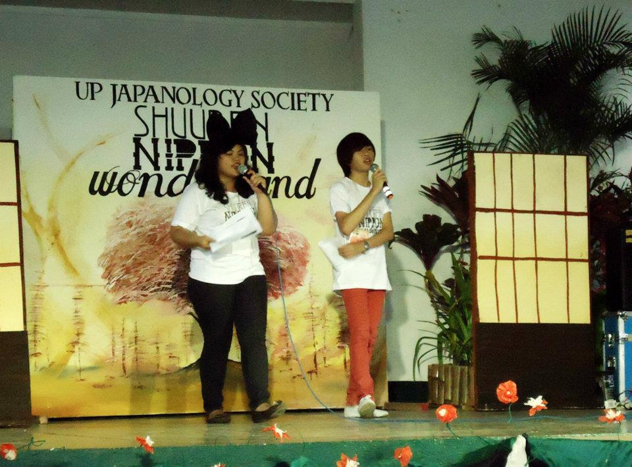
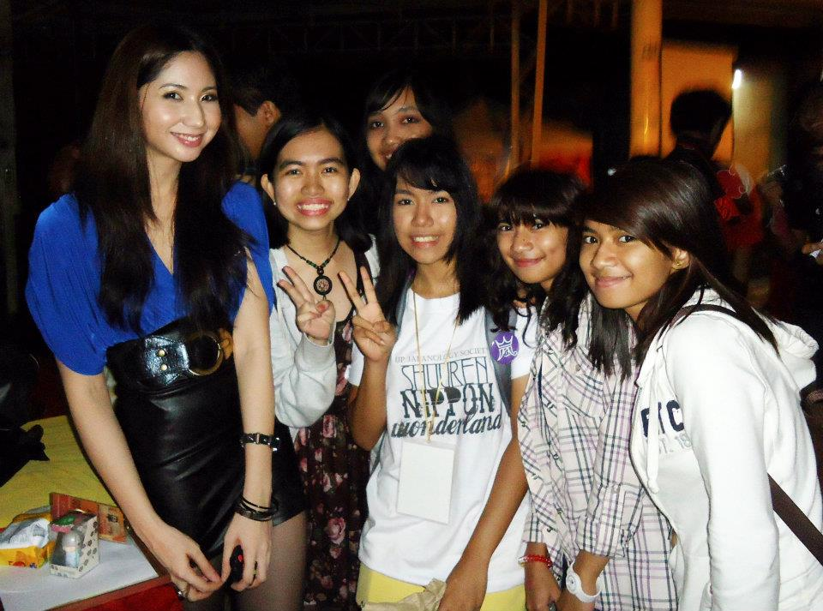
shuuren
One of the org’s main activities that helps people to know more about the Japanese culture through vast activities in one event.
_{org}
activities

Slide 5

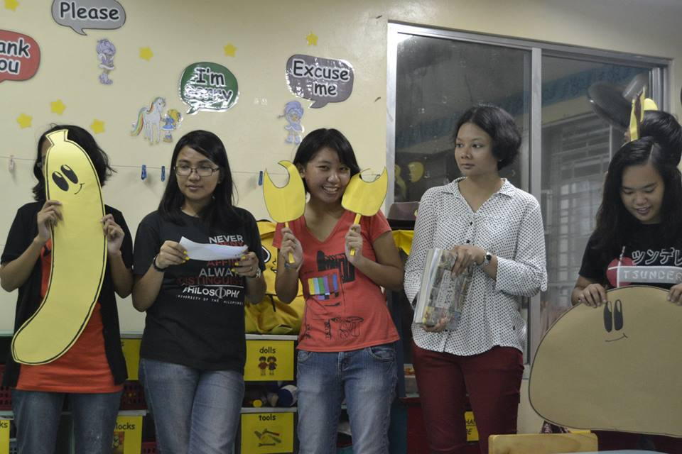
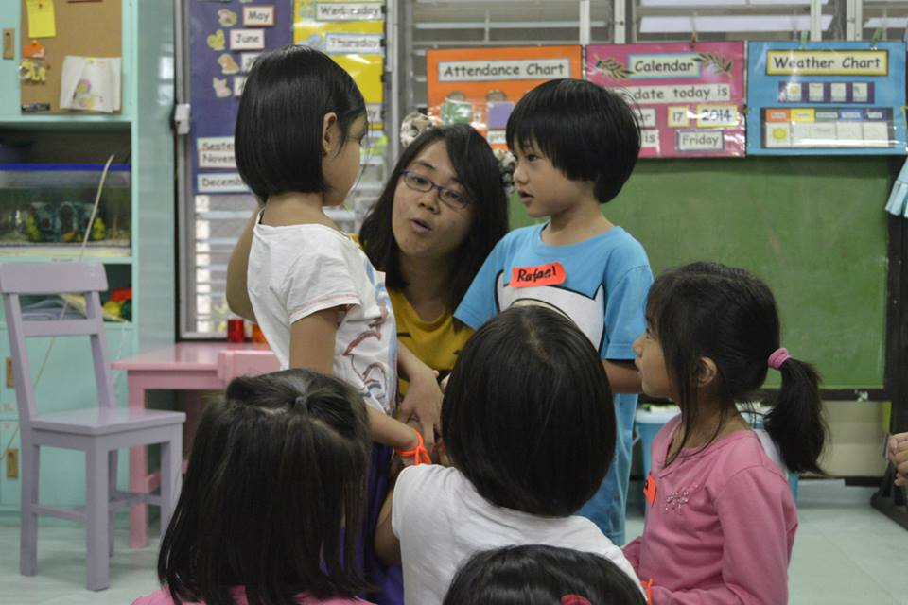
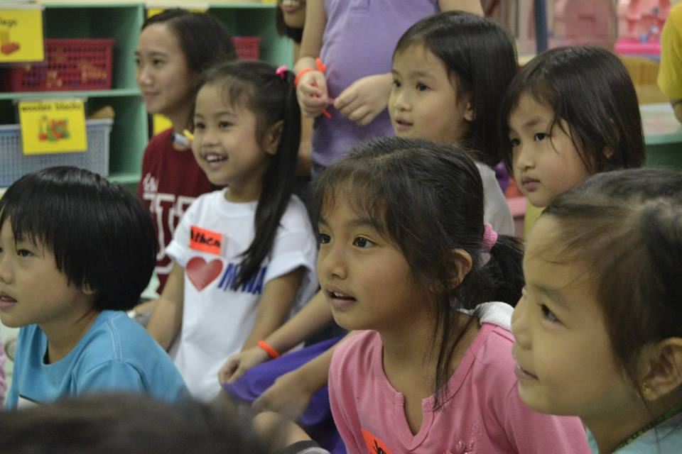
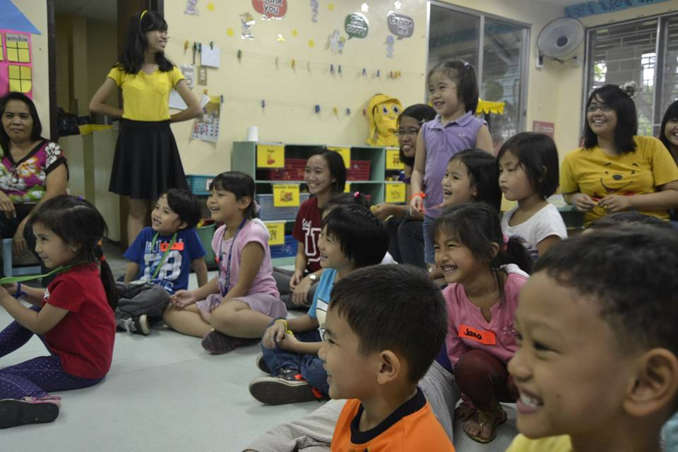
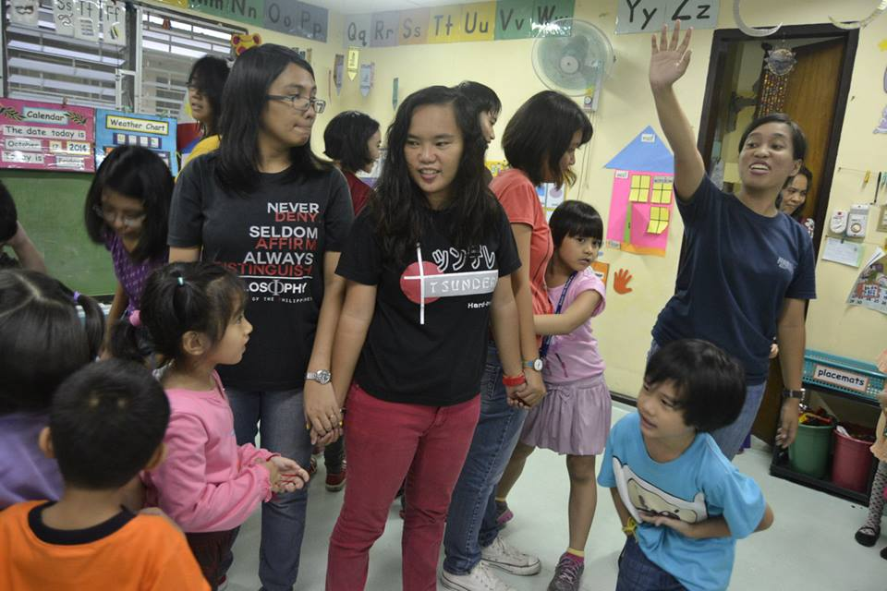
_{org}
activities
outreach program
As a socio-civic organization, UP Japsoc does not only focused on culture-based activities but on outreach programs as well. Activities include tree planting, gift giving, etc.

Slide 6

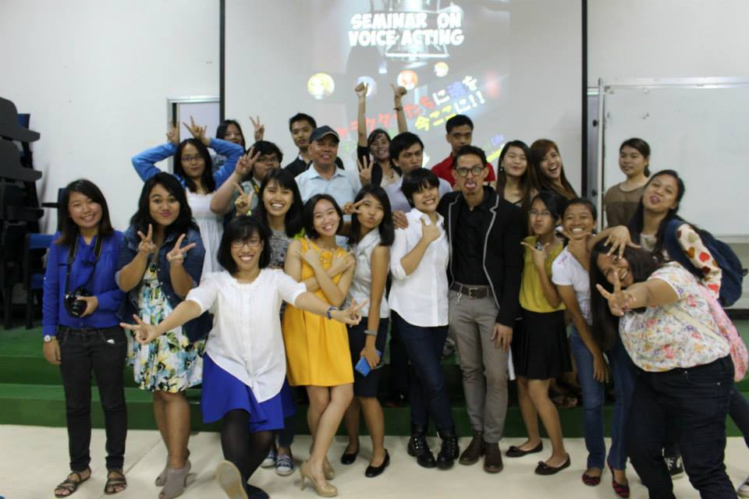
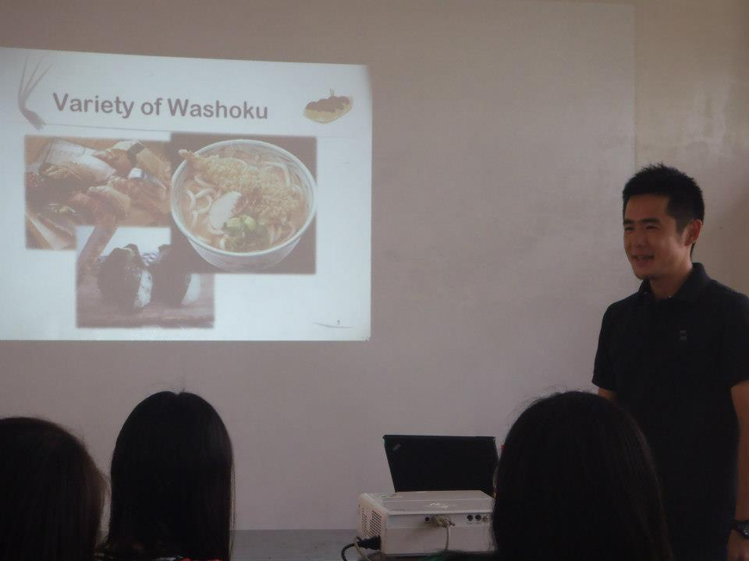
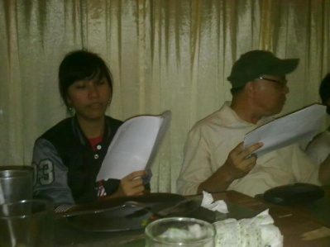
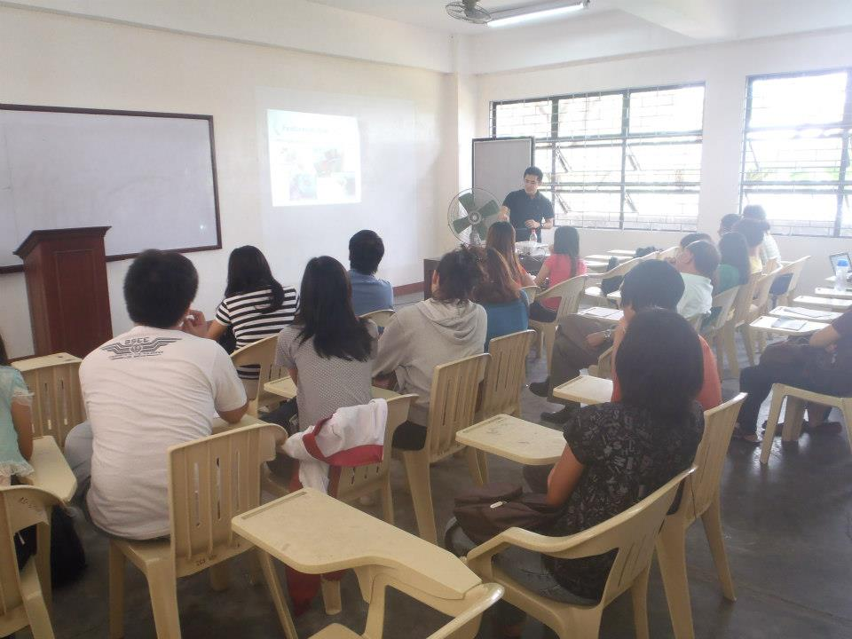
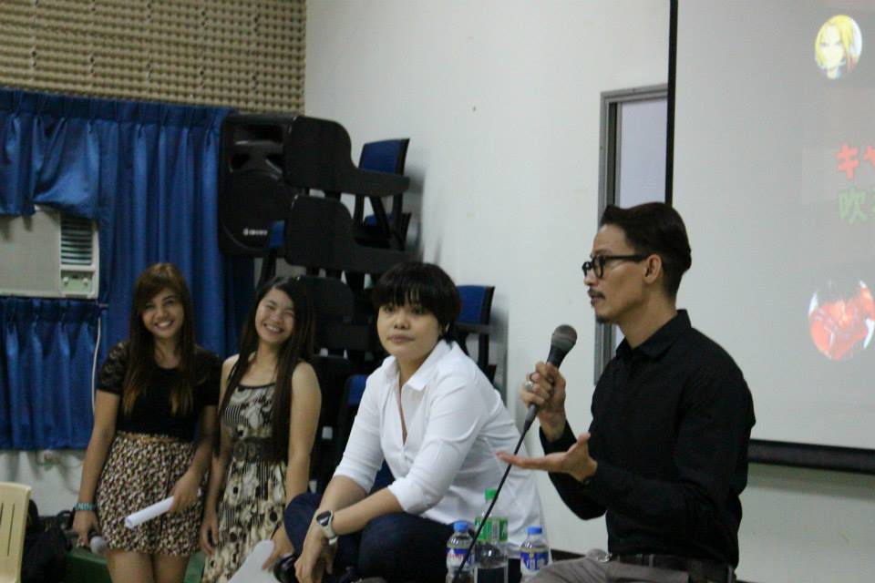
_{org}
activities
seminars.

Slide 7

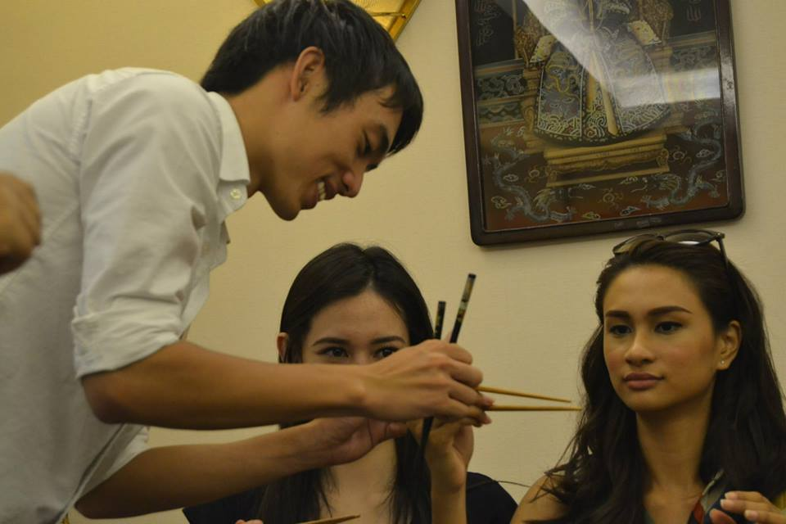
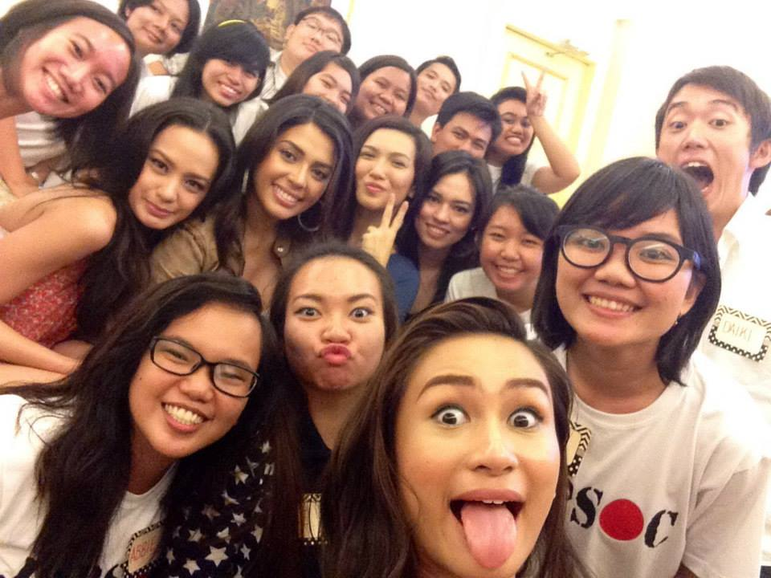
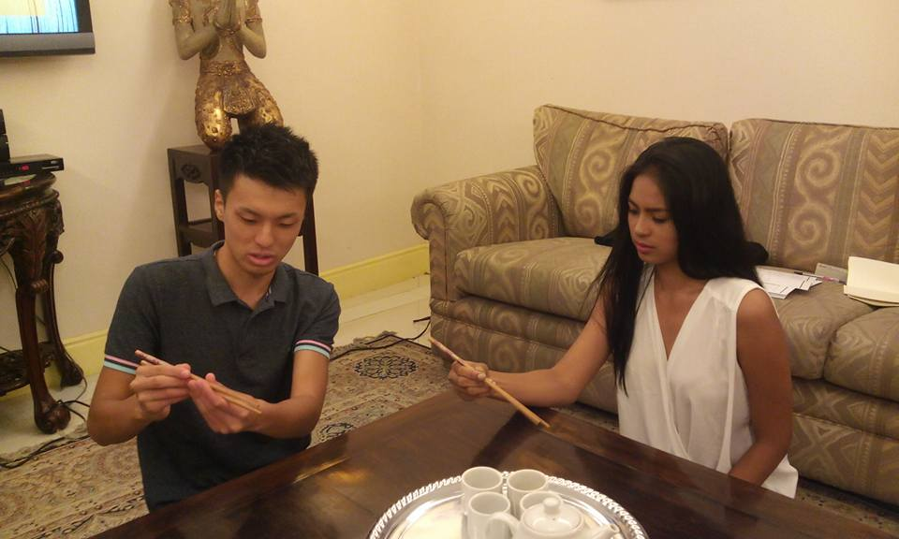
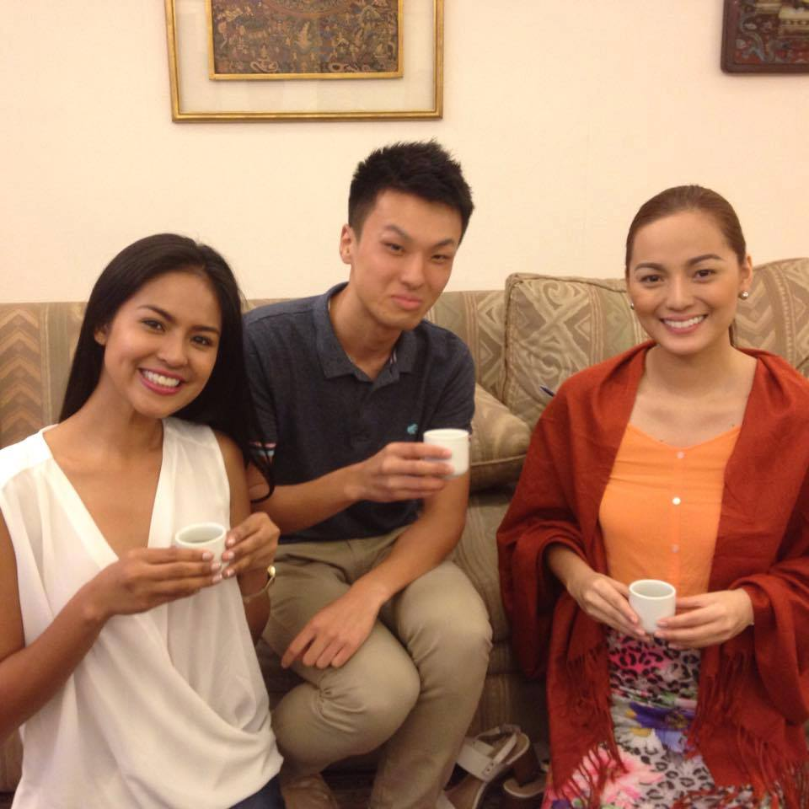
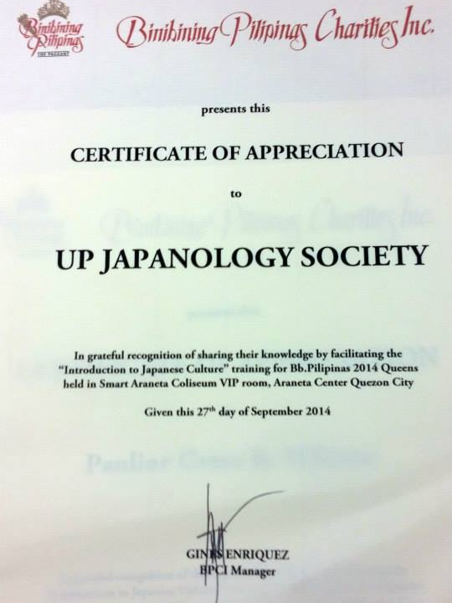
Japanese culture sharing with BB. Pilipinas representatives.
_{org}
activities

Slide 8

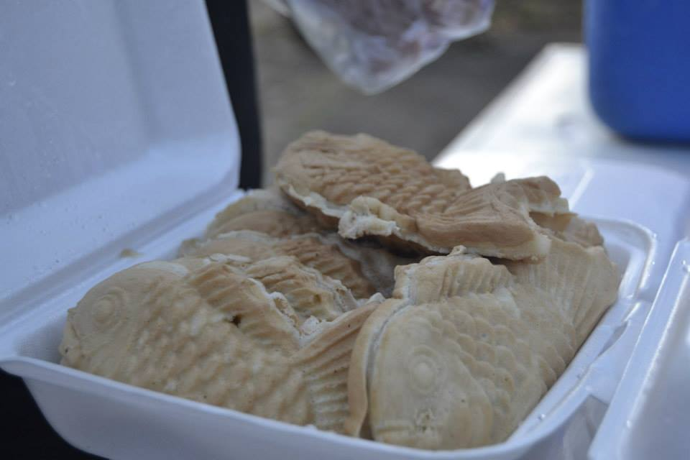
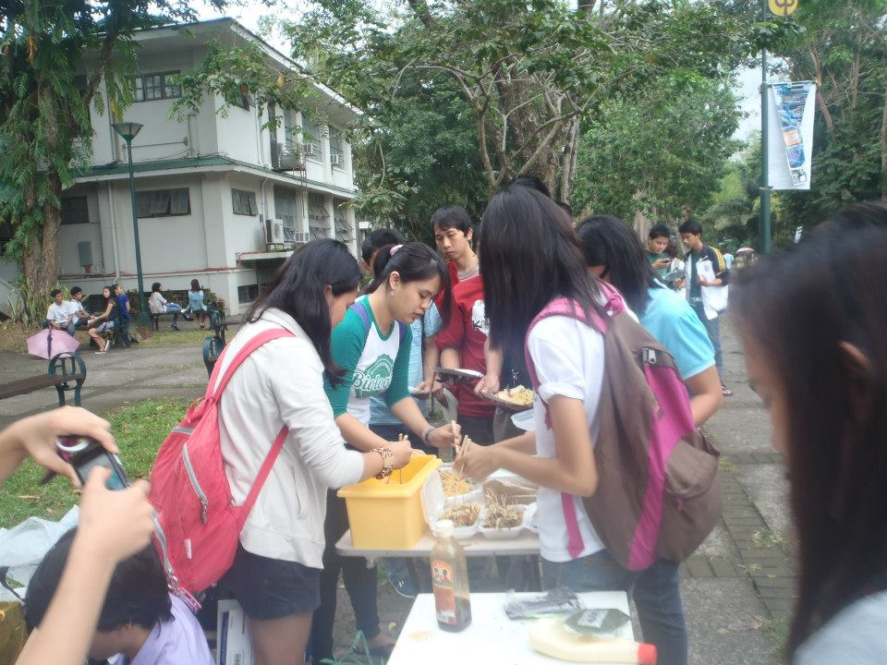
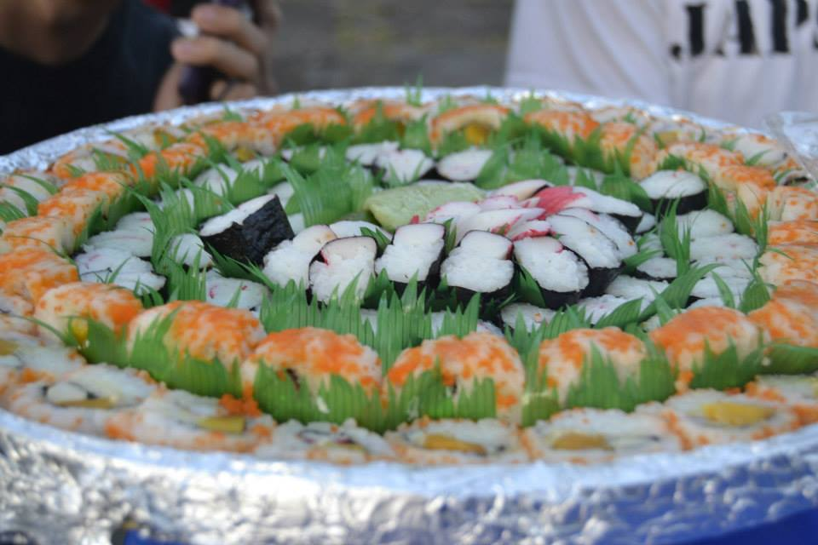
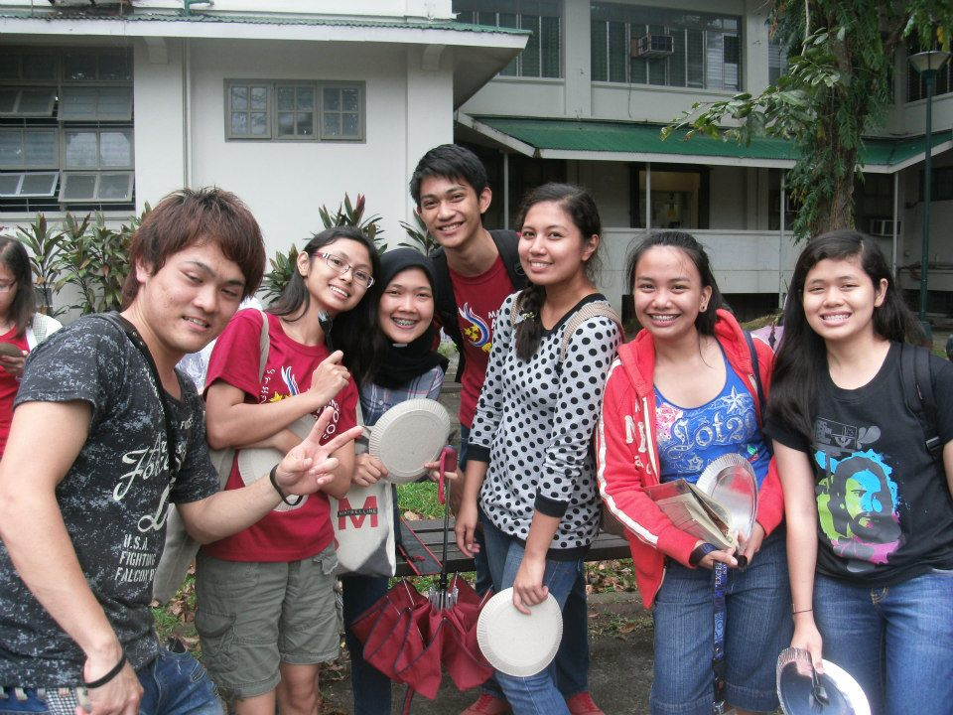
Food fest
_{org}
activities

Slide 9

_{RESIDENT}
_{MEMBERS}

Slide 10

Alyssa Ana Arianne Cathy Doy Isa Jen Mika Myrtel Nikola Nina Pauline Rayv Riki Reg Roselyn Sarah Sunshine Tips Verna Yeshua Nana EJ Kim Kuri MC Sweetcel alecs per tin gladys imara rei judy

